Slide 1

Management Internship Symposium
2023
Name – A. Mithursan
Reg No – MG/17/085
Department- Management Studies

Slide 2
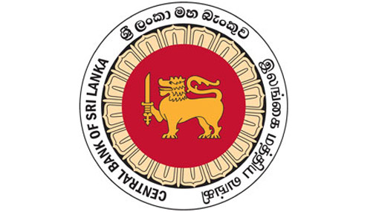

Internship Provider:
The Central Bank of Sri Lanka
Specialization Area :
Organizational Management
Professional Qualifications:
CA Sri Lanka, CR Level (R)
Other Achievements:
Batch top in the Major Module
Gold medalist for the Innovation Day Competition
Finalist of International INNOTAL Business Pitching Competition
A. Mithursan
MG/17/085

Slide 3

Content
P1
Industry & Self Reflection
Nature of the Organization
Tasks, Duties, Responsibilities and Reporting structure
General Experience & Knowledge Insights
P2
Case Study Analysis
Problem Identification
Findings
Recommendations

Slide 4
Nature of the Organization
Introduction to the Central Bank of Sri Lanka (CBSL)
The CBSL is the main administrative body (apex institution) that governs the functions of financial sectors in Sri Lanka
Established by the Monetary Law Act (MLA) No.58 of 1949
Commenced operations on August 28, 1950
Objectives
1. The maintaining of economic and price stability 2. The maintaining of financial system stability

Slide 5
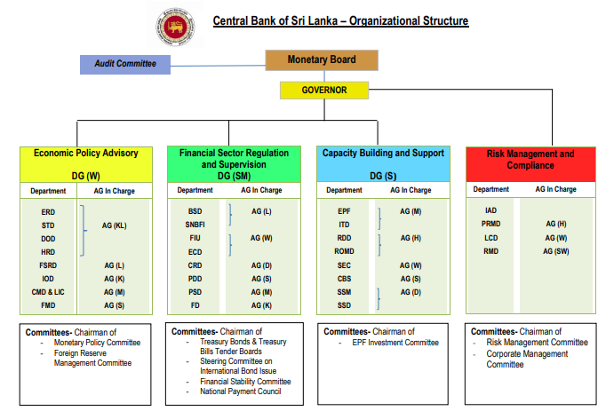
Nature of the Organization
Departments worked with:
Economic and Research Department (ERD)
Policy Review and Monitoring Department (PRMD)
Banking and Supervision Department (BSD)
Finance Department (FD)
EPF Department (EPFD)
Internal Audit Department (IAD)
(Source: CBSL website)

Slide 6
Description of Task, Duties, responsibilities and Reporting structure
Had sessions with top-level officials of each division in the departments
Doing presentations, Data analysis & forecasting, and tasks assigned by the supervisors
Facing interviews, examinations, preparing financial statement analysis, Group works, learning by doing, asset verification, Government securities evaluations
Worked with senior economists (Annual report chapter analysis), conducted mini research on “Sri Lanka’s Position in Global Innovation Ranking”,
Analyzed the key economic and social factors proposed in the budget 2023 (PRMD), present the application of the FHC concept in other countries, Prepared an Annual Audit plan for PAN ASIA Bank and Financial statement analysis (BSD)
Visited the highly secured currency department, and museum and interacted with Governor

Slide 7
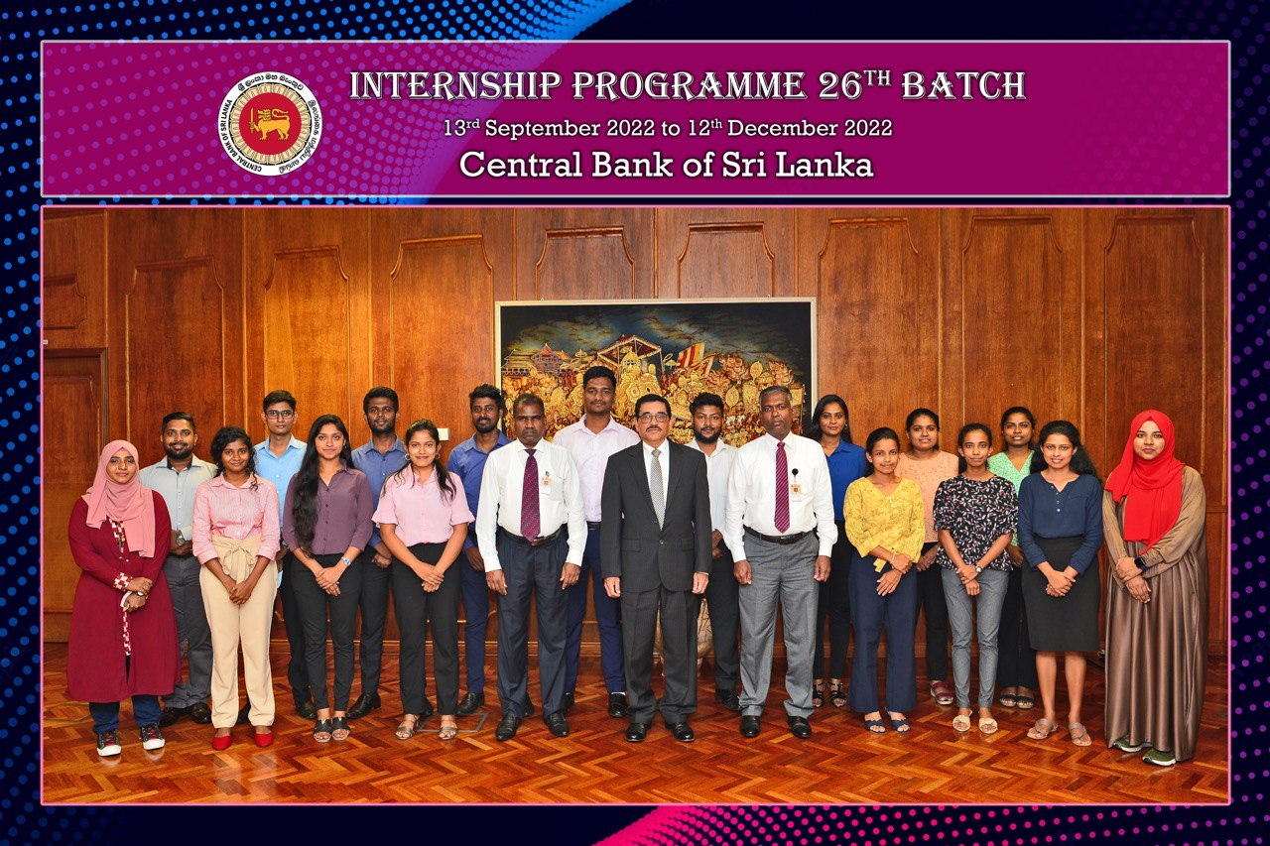
Self Reflection
Internship Experience
CBSL internship was a great opportunity for an Organizational Management student to understand the practical application of theories, concepts, and models that I learnt from my specialization. The learning sessions, on-the-job training, and banking professional guidance helped me to excel in my soft skills, competencies, and professionalism. I never dreamt that I would meet these inspired economists, and the governor of the CBSL. Fortunately, I worked with them, and this is an unforgettable learning experience in my life.

Slide 8
Self Reflection
Specific Knowledge and Insights
Departments | Applications of theories, concepts, and models in the CBSL
ERD | Law of Demand & Supply, CCPI & NCPI, Inflation, SDGs, theoretical approach to poverty, economic indicators, FIT, IMF Facilities, self sufficiency etc.
PRMD | Strategic Management (Action plan, KPI) and planning process, vision, mission building, setting future directions, Internal & External environment analysis, Business communication, corporate governance etc.
BSD | Holding company concept, MIS, Corporate finance, Sustainable development, customer charter, Group consolidated supervision, Foreign exchange risk assessments, Financial statement analysis
FD | FDI, IMF facilities, Nostro A/C, foreign reserves, Government securities, Budgeting, SWIFT, SLIP, RTGS and IFRS etc.
EPFD | Customer relationship management, Business process model (BPM) Business process review, Project management tools, and techniques business administrations functions
IAD | Code of ethics, Audit functions, process, risk audit universe, QARM

Slide 9
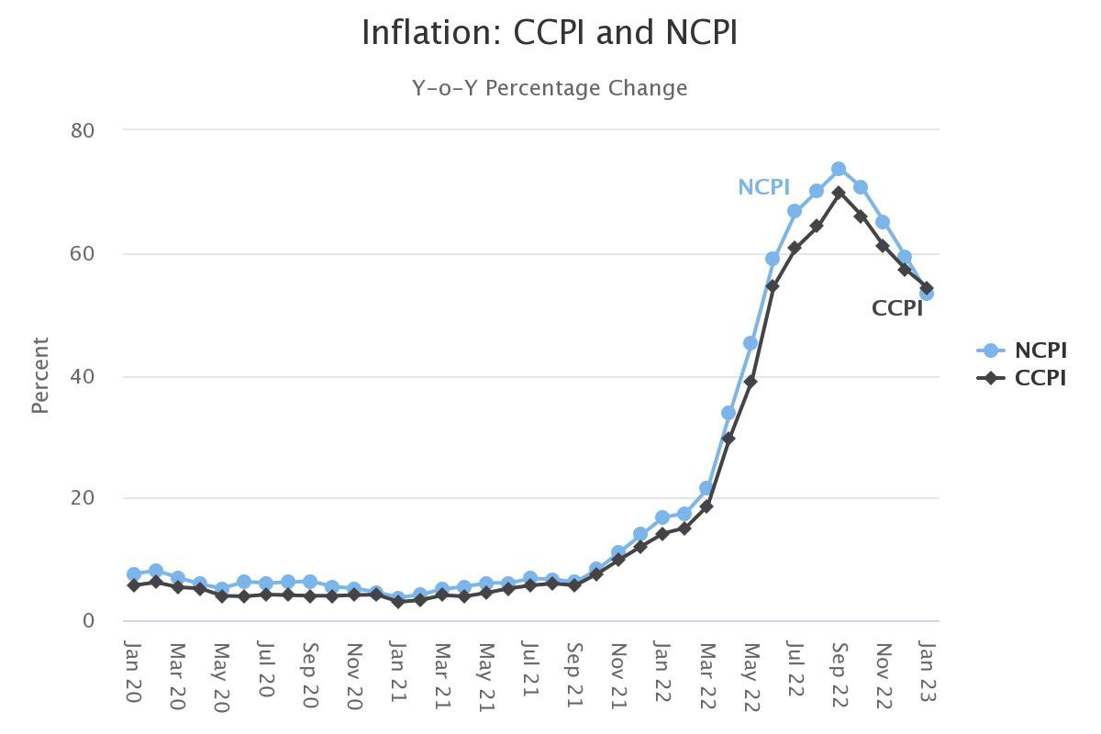
Case Study Analysis
“IT TAKES TWO TO TANGO”
Can the Monetary Policy of the Central Bank of Sri Lanka alone control Inflation?
Problem Identification
The hot topic was in the monetary policy of the Central Bank of Sri Lanka
The objective of price and economic stability was questionable.
Does the decreasing inflation mean that prices of goods and services will go down?
Inflation or the contraction of the economy has a severe impact on the public standard of living
(Source: CBSL Website)

Slide 10
Case Study Analysis
Can the Monetary Policy of the Central Bank of Sri Lanka alone control Inflation?
Problem Identification
Price
Inflation is driven by two different forces either demand- pull or cost-push inflation
The tightening/ monetary policy tools can’t control the inflation driven by the supply side.
High price pressure exists due to supply-side inflation, 80 % currency depreciation because of global price increases in food and fuels (Weerakoon, 2022).
AS1
AD1
AS2
P1
P*
AD2
Q*
Q1
GDP

Slide 11
Findings
NCPI based headline inflation recorded at 73.7% on year-on-year basis in September 2022 (CBSL website, 2023). Today, Inflation rate (NCPI) is 1.00% (CBSL website, 2023).
Japan inflation rate is 3.3% (Source: Bank of Japan) Are we heading than Japan?
Steve H. Hanke, a professor at Johns Hopkins University states suggests
During 2022, the Sri Lanka was among the top 10 countries with high inflation.
However, It appears that inflation is finally well under control and remains within the comfortable corridor of the central bank. Yes, inflation is in single digits, yet prices remains elevated. Many people ask this question. If inflation is in single digits, why prices are so high?
Domestic inflation in Sri Lanka reached a peak of 69.8% in September 2022. This means the general price level in the country increased by 69.8% in comparison to the previous year.
Lower inflation means that the rate at which the prices are increasing is indeed lower. This does not mean that prices are coming down. The price level in fact increases, but at a much lower pace

Slide 12
Findings
Sir Mervyn King, former Governor of the Bank of England (BOE), explained why managing inflation is so important: “Once higher inflation becomes entrenched, it may be costly to dislodge. The best thing that we can do to promote economic stability is to avoid inflation, and inflation expectations”
One of the most immediate and visible costs of inflation is the erosion of purchasing power & Food and beverage industry operating Sri Lanka are susceptible in this context.
Sustained inflation can create uncertainty in the economy. When businesses are uncertain about future prices, they may delay investment decisions or raise prices, which can dampen economic growth.
Inflation can distort price signals in the economy. When prices rise due to inflation rather than changes in supply and demand, it becomes more challenging for businesses and consumers to make informed decisions about resource allocation. This can lead to misallocation of resources and inefficiencies in the economy.
The public is concerned why prices are not coming down when inflation is low. Inflation measures the movement of the prices. It does not reflect level of prices. Lower inflation means the prices are still going up, albeit at a lower rate.
(Somaratne, 2023)

Slide 13
Case Study Analysis
Recommendations
The expectational IS and LM model to strengthen the monetary policy
Neo-classical economic models towards productivity improvement
Successful sustainable policy Implementation
Flexible Inflation Targeting (FIT)

Slide 14
Case Study Analysis
Recommendations
Alternative supply-side mechanisms to achieve price stability
Self-sufficiency Approach
Increasing usage of digital currency in circulation
The role of economic agents in succeeding inflation targeting

Slide 15
References
Weerakoon, D. (2022). Sri Lanka’s Runaway Inflation and the Limits of Monetary Policy. [online] IPS/ Talking economics. Available at: https://www.ips.lk/talkingeconomics/2022/07/27/sri-lankas-runaway-inflation-and-the-limits-of-monetary-policy/.
Central Bank of Sri Lanka website. Available at: https://www.cbsl.gov.lk/en (Accessed: February 6, 2023).
Latest news, analysis and opinions from the Daily FT, Sri Lanka's latest business updates. Inflation is falling, what is happening to prices? | Daily FT
Weerasinghe, P.N., 2018. Evolution of monetary and exchange rate policy in Sri Lanka and the way forward. Staff Studies, 48(1).
Abeygunawardana, K., 2017. Inflation targeting in Sri Lanka: the fiscal challenge. Economic Research, 4, p.2.

Slide 16
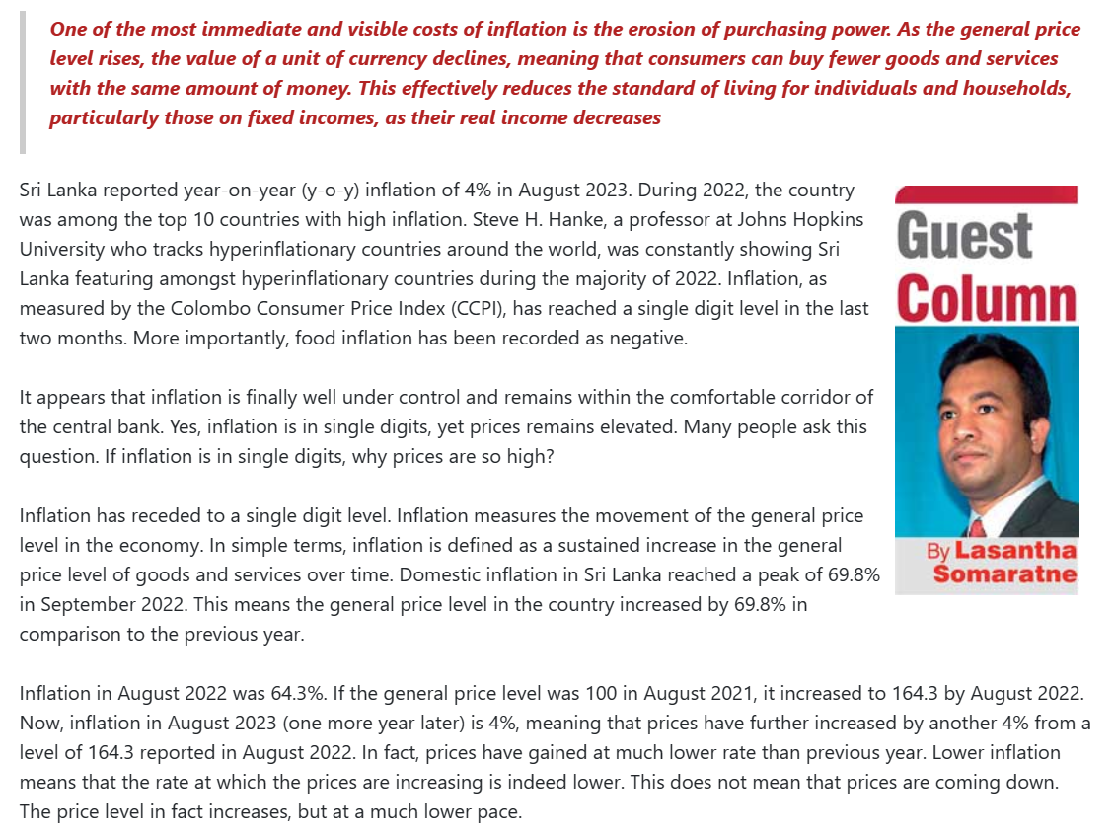
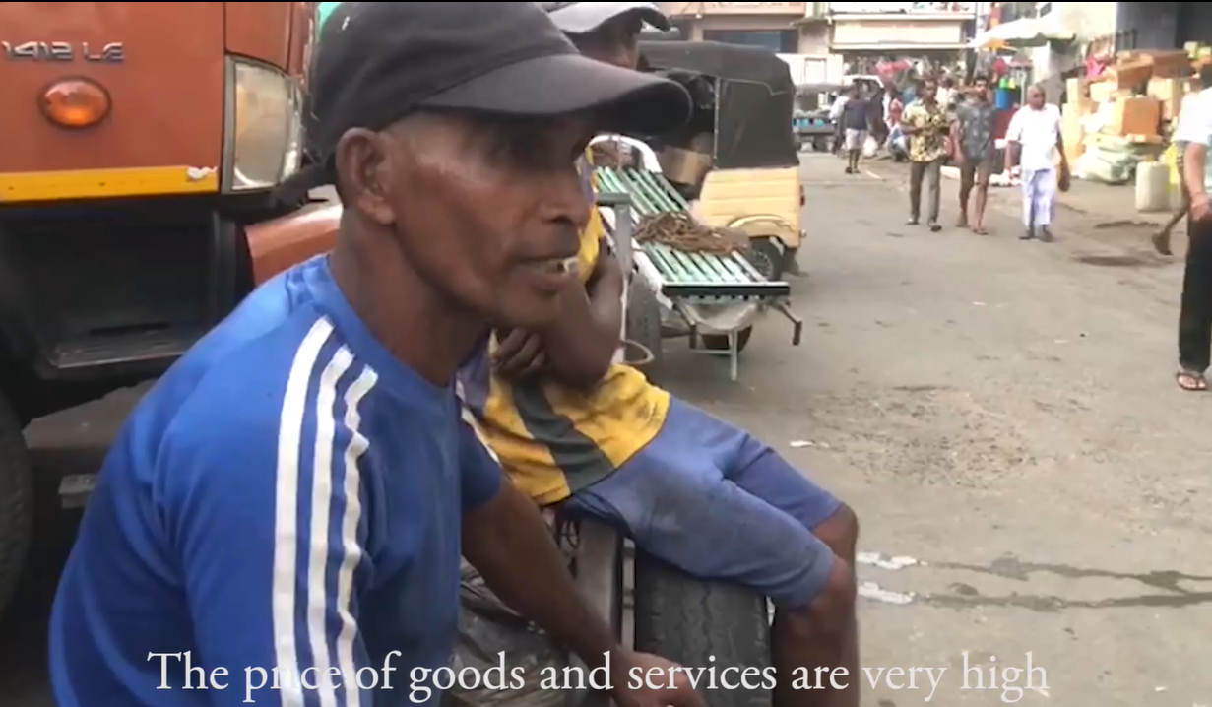
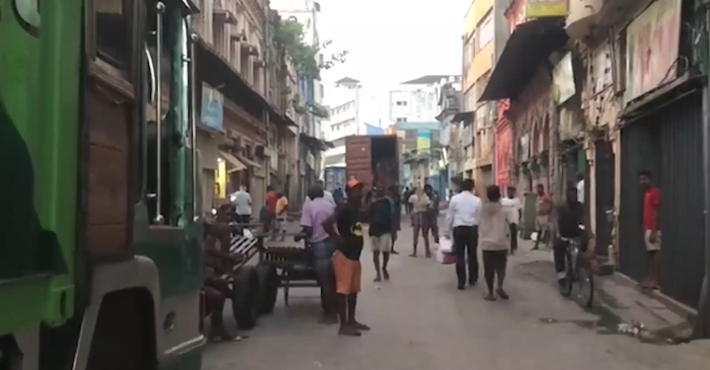
Annextures

Slide 17
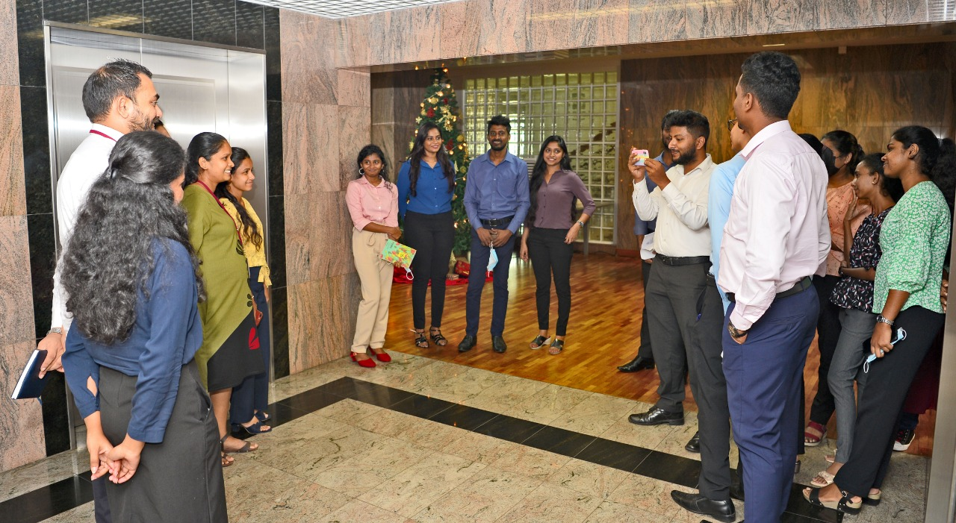
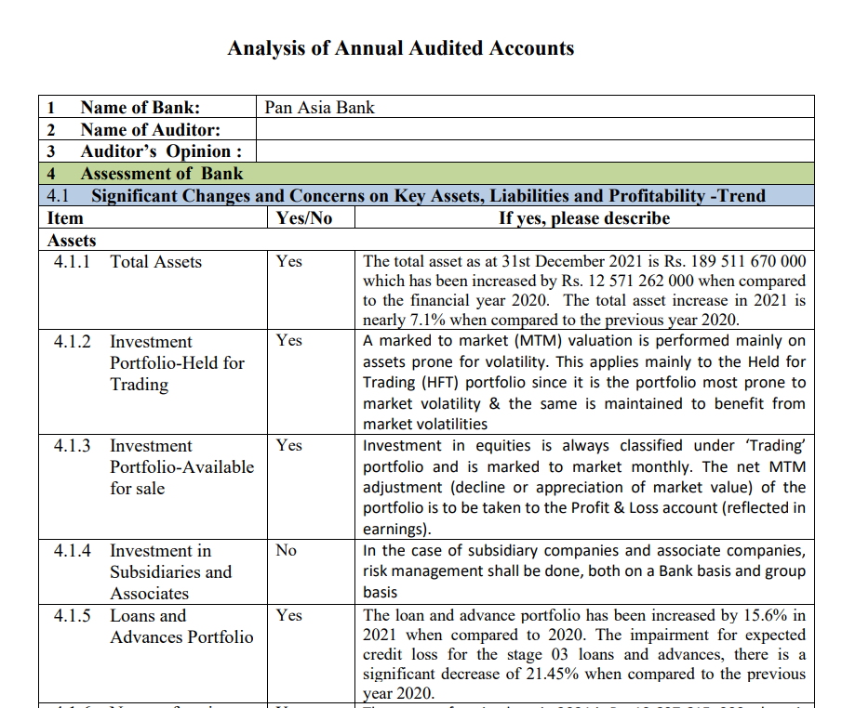
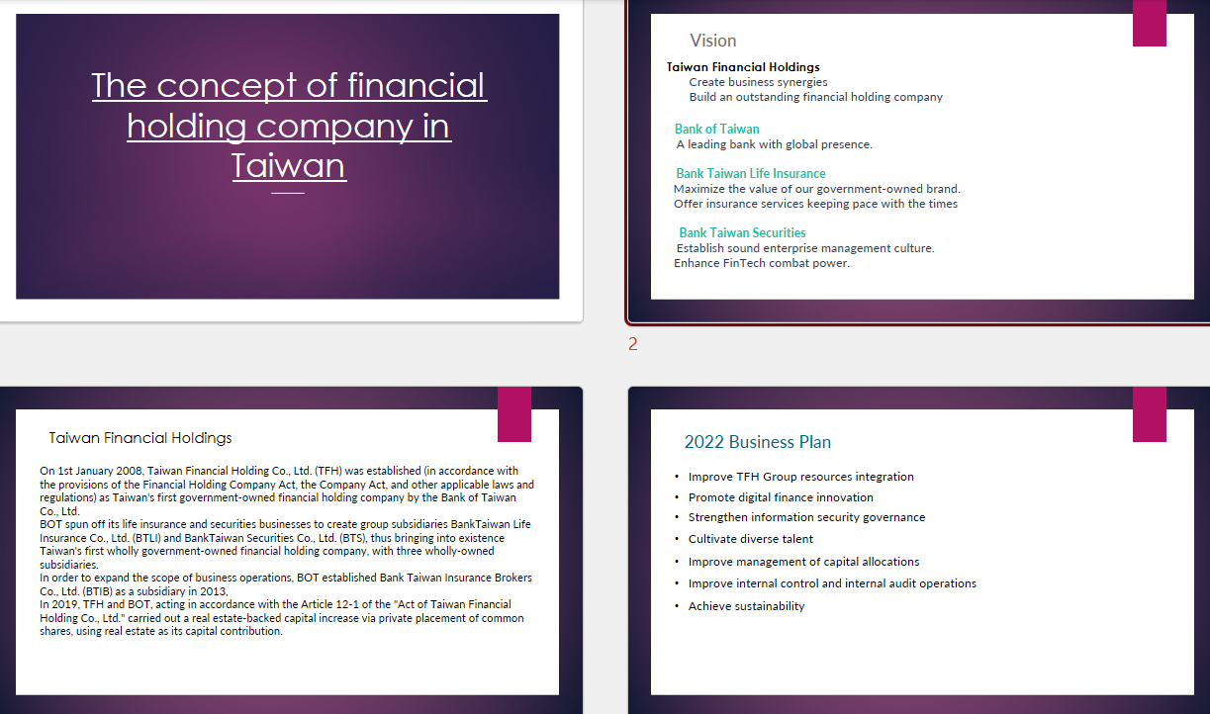
Annextures

Slide 18

Thank You !

Slide 19
Q & A
MG/17/085

